Slide 1
HTTP/2 and the changing protocols of the web
Barry Pollard – April 2019
Image credit: By Fabio Lanari - Internet1.jpg by Rock1997 modified., CC BY-SA 4.0, https://commons.wikimedia.org/w/index.php?curid=20995390

Slide 2
What is HTTP?
HTTP is one of 3 technologies invented by Tim Berners-Lee when inventing the web:
URI – Universal Resource Identifier
HTTP - Hypertext Transfer Protocol
HTML – Hypertext Markup Language
http://www.example.com
GET /page.html HTTP/1.1
HTTP/1.1 200 OK
<html>
<head>
<title>This is HTML</title>
</head>
<body>
<h1>A heading</h1>
<p>A paragraph</p>
</body>
</html>

Slide 3
“Things can change so fast on the internet.”
Tim Berners-Lee

Slide 4
History of HTTP
HTTP has had surprisingly few changes in it’s lifetime.
HTTP/0.9 - 1990
HTTP/1.0 - 1996
HTTP/1.1 - 1997
…
…
…
HTTP/2 - 2015
HTTP/3 – 2019/2020?

Slide 5
What is HTTP/2?
HTTP/2 was primarily designed to improve the performance of the web as the web had changed a lot since HTTP/1:

Slide 6
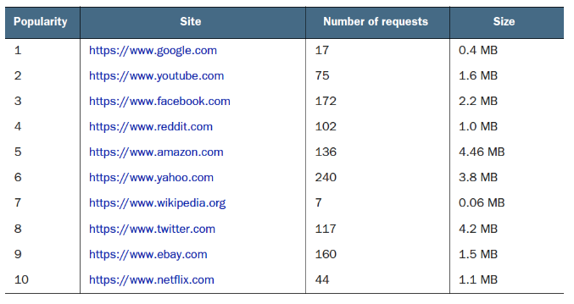
What is HTTP/2?
HTTP/2 was primarily designed to improve the performance of the web as the web had changed a lot since HTTP/1:

Slide 7
What is HTTP/2?
HTTP/2 was based on a protocol called SDPY invented by Google.
It introduces the following changes compared to HTTP/1:
Binary rather than textual protocol
Multiplexed rather than synchronous
Flow control
Stream prioritization
Header compression (HPACK format)
Server push
Connection coalescing

Slide 8
What does “binary format” mean?
HTTP/0.9, HTTP/1.0 and HTTP/1.1 are all text based.
The bodies can be binary (e.g. gzip, images) but the requests and headers are text based.
Only structured by line breaks/carriage returns.
GET /index.html HTTP/1.1
Accept: text/html, */*
Accept-encoding: gzip, deflate, br
User-agent: MyAwesomeBrowser 40.3
HTTP/1.1 200 OK
Content-encoding: gzip
Content-length: 17029
Content-type: text/html
ZE<9B><87><8E>F<F6>$Y<A4>^ʹI^Z<B4>^E<92>M<B>v<B1>
HTTP/2 sends HTTP messages in a binary frames – similar to IP packets or TCP packets.
Packet field length and values are clearly defined and easier to parse.
+-----------------------------------+
| Length (24) |
+----------+-----------+------------+
| Type (8) | Flags (8) |
+-+--------+-------------------------------------+
|R| Stream Identifier (31) |
+=+==============================================+
| Frame Payload (0...) ...
+------------------------------------------------+

Slide 9
Sniffing packets

Slide 10
Fetching a web page under HTTP/1.1

Slide 11
Downsides of multiple connections

Slide 12
Fetching a web page under HTTP/2

Slide 13
HTTP/1.1 versus HTTP/2
Live demo: http://http.tunetheweb.com/performance-test-360/

Slide 14
Fetching a web page with HTTP/2 push
WARNING: It’s easy to over push – wasting bandwidth and making your site slower. For this reason HTTP/2 push has not taken off much

Slide 15
Who uses HTTP/2?
Image credit: https://caniuse.com/#feat=http2

Slide 16
Who uses HTTP/2?
Most major sites! All of the sites mentioned on slide 6 use HTTP/2
You have been using HTTP/2 for 3 years without realising it. And longer if you include SDPY that is was based on!

Slide 17
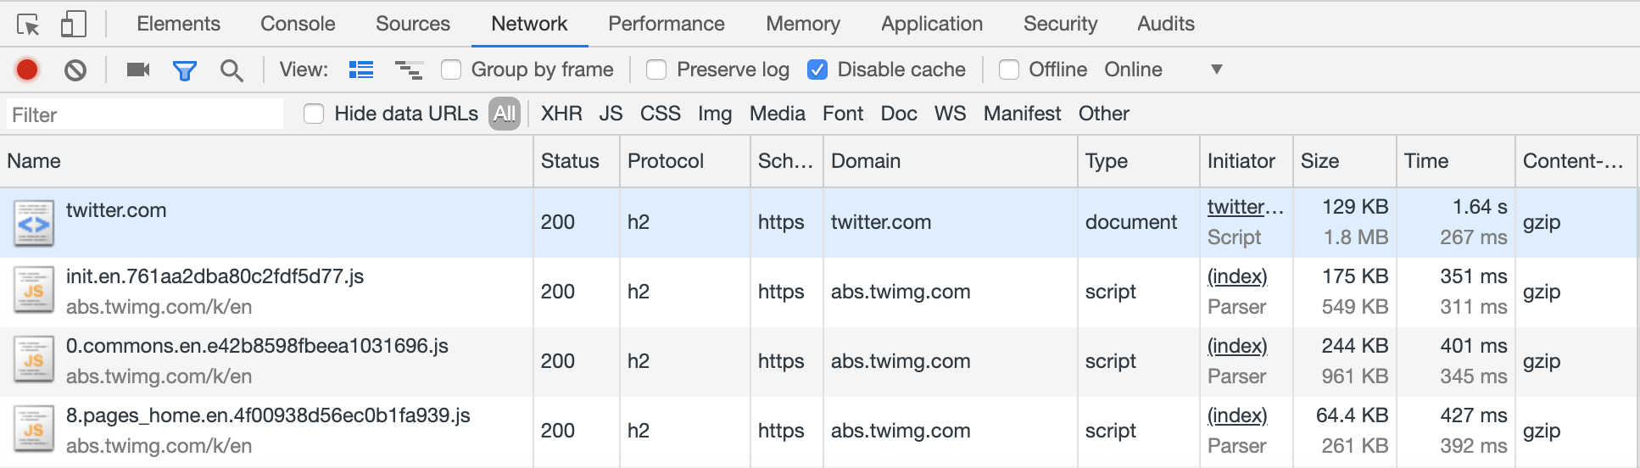
Who uses HTTP/2?
HTTP/2 uses the same https:// scheme and default 443 port number.
As part of the TLS negotiation it used ALPN to confirm both sides can talk HTTP/2
Add protocol column to Developer Tools to see which sites use it:

Slide 18
The secret message that starts every HTTP/2 connection
The first message that MUST be sent on an HTTP/2 connection is a sequence of 24 octets and looks like this in hex notation:
Why? Well this sequence translates to the following message in ASCII:
Which is a gibberish HTTP/1-like message:
Why PRI SM? Well it used to be FOO BA and STA RT was also proposed but something happened in 2013 that caused the HTTP-WG to exercise “editorial discretion” ☺
0x505249202a20485454502f322e300d0a0d0a534d0d0a0d0a
PRI * HTTP/2.0\r\n\r\nSM\r\n\r\n
PRI * HTTP/2.0
SM

Slide 19
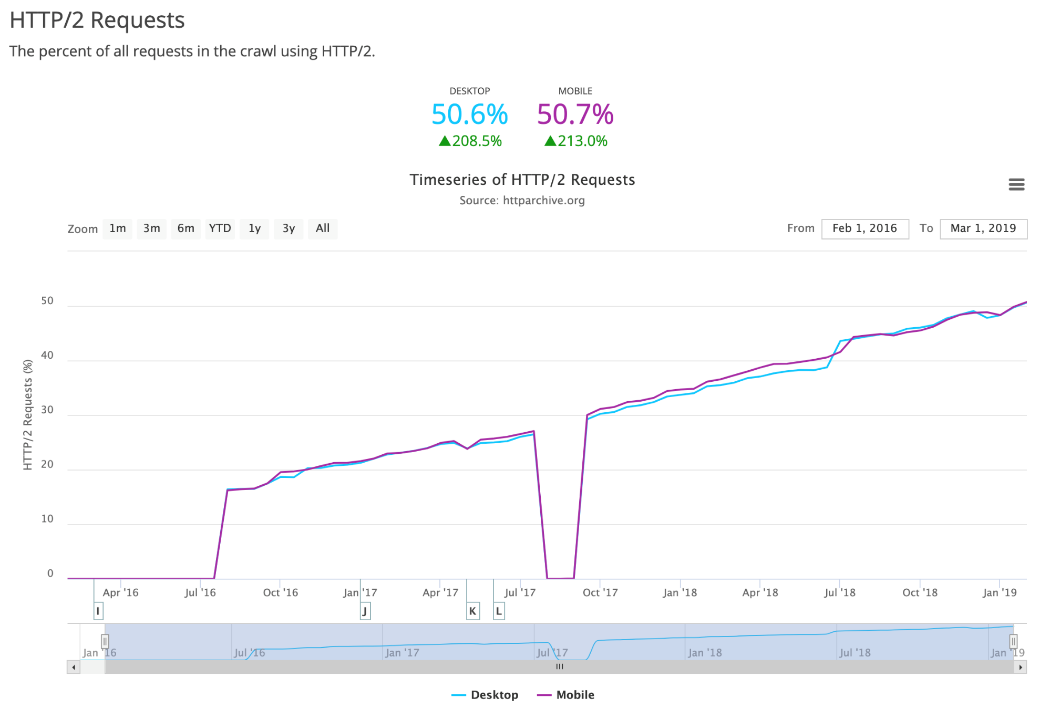
Image credit: https://httparchive.org/reports/state-of-the-web#h2

Slide 20
How to enable HTTP/2 on your site?
Find your edge infrastructure (webserver, load balancer, CDN) and enable there.
For Apache that means adding this config:
For nginx it’s a simple as adding http2 to your listen directive on your HTTPS server:
For IIS and most CDNs it is enabled by default – you may already be using it!
If your version of your web server supports HTTP/2 (and that’s a big if) then it’s a simple as that! And most sites should see immediate performance benefits.
However there are a number of subtleties and nuances (a whole book’s work!). To truly optimise for HTTP/2 may require changing development practices.
LoadModule http2_module modules/mod_http2.so
Protocols h2 http/1.1
server {
listen 443 ssl http2;
listen [::]:443 ssl http2;

Slide 21
Security implications of HTTP/2?
HTTP/2 requires some thought on security side:
Binary format is more difficult to read (for humans – not for computers)
HPACK compressed format requires tracking state
Always encrypted (for browser traffic)
Support may not be available on network tools
Implementation issues (e.g. recent Microsoft vulnerability)
Connection coalescing can lead to interesting issues
On plus side:
Always encrypted (for browser traffic) and mandates strong TLS encryption
Reduces chance of line break attacks and other text interpretation errors

Slide 22
HTTP/3 and QUIC
Image credit: http://www.commitstrip.com/en/2018/11/15/http-3/?

Slide 23
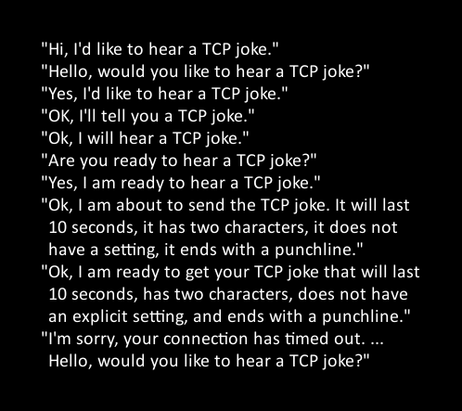
What’s wrong with HTTP/2?
HTTP/2 was still based on TCP
While TCP is a very well used, stable, protocol it has a number of inefficiencies:
Guaranteed delivery at connection level
Long set-up time esp. when combined with TLS
Very cautious (TCP slow start)
Reacts badly to packet loss
Ossification
Google invented QUIC to address these issues

Slide 24
What is QUIC and HTTP/3?
QUIC is a UDP-based replacement for:
TCP
Most of HTTPS (though uses most of TLSv1.3)
Parts of HTTP/2
HTTP/3 is a lighter variant of HTTP/2 without transport level parts.

Slide 25
Benefits of QUIC
QUIC was designed with the following principals in mind:
Dramatically reduced connection establishment time
Improved congestion control
Multiplexing without HOL line blocking
Forward error correction
Connection migration
HTTP/3 is but the first use case of QUIC – others are expected to follow.
QUIC is being position an alternative to TCP but to avoid the ossification issues of TCP, QUIC will be based in user space and be almost entirely encrypted.

Slide 26
Using Encryption to beat Ossification
QUIC is almost entirely encrypted compared to TCP
1 bit (the spin bit) has been proposed, which will alternate at client or servers request, to allow network operators to have some visibility of QUIC traffic. It is controversial so may not even be approved.
Image credit: https://calendar.perfplanet.com/2018/quic-and-http-3-too-big-to-fail/

Slide 27
When will QUIC arrive?
Google QUIC (aka gQUIC) is already here if using Chrome and Google sites:
IETF QUIC (including HTTP/3) is due to be completed by July 2019 (but has been delayed before!), and then it will take a few months to officially approve.
However implementations do not yet exist for popular web servers (Nginx, Apache) and will require changes to TLS libraries.

Slide 28
Security implications of QUIC and HTTP/3?
QUIC is a massive change to the internet landscape
Based on UDP rather than the TCP that most applications are based upon
Entirely encrypted – even spin bits are controversial
May iterate quickly
May not follow usually TCP congestion control algorithms
Better security and privacy for end users
Has received a Human Rights review:
https://tools.ietf.org/html/draft-martini-hrpc-quichr-00
“The QUIC protocol provides significant human rights improvements for end users.”

Slide 29
Conclusion: The web protocols are going through some interesting times!
But all versions of HTTP will be with us for some time
Image credit: https://xkcd.com/1782/

Slide 30
Thanks for Listening! Check out my book: Questions? (free ebook for first 5 questions!)
Special for Cork Sec:
Use code: mtpcorksec19
for 40% off this and all other books on www.manning.com
I blog at: www.tunetheweb.com
And tweet at: @tunetheweb
Image credits: Unless otherwise noted, images and animations were taken from above book. Please feel free to use with attribution

